Slide 1


SNAP: Towards Segmenting aNything in Any Point Cloud 3DV 2026 Oral & Award Candidate
Aniket Gupta^{1*}, Hanhui Wang^{1*}, Charles Saunders², Aruni RoyChowdhury², Hanumant Singh¹,Huaizu Jiang¹
¹Northeastern University, ²MathWorks
*Equal Contribution
Presenter: Hanhui Wang
Boston AI, ML and Computer Vision Meetup
Microsoft Research Lab – New England (NERD) at MIT
February 18, 2026

Slide 2
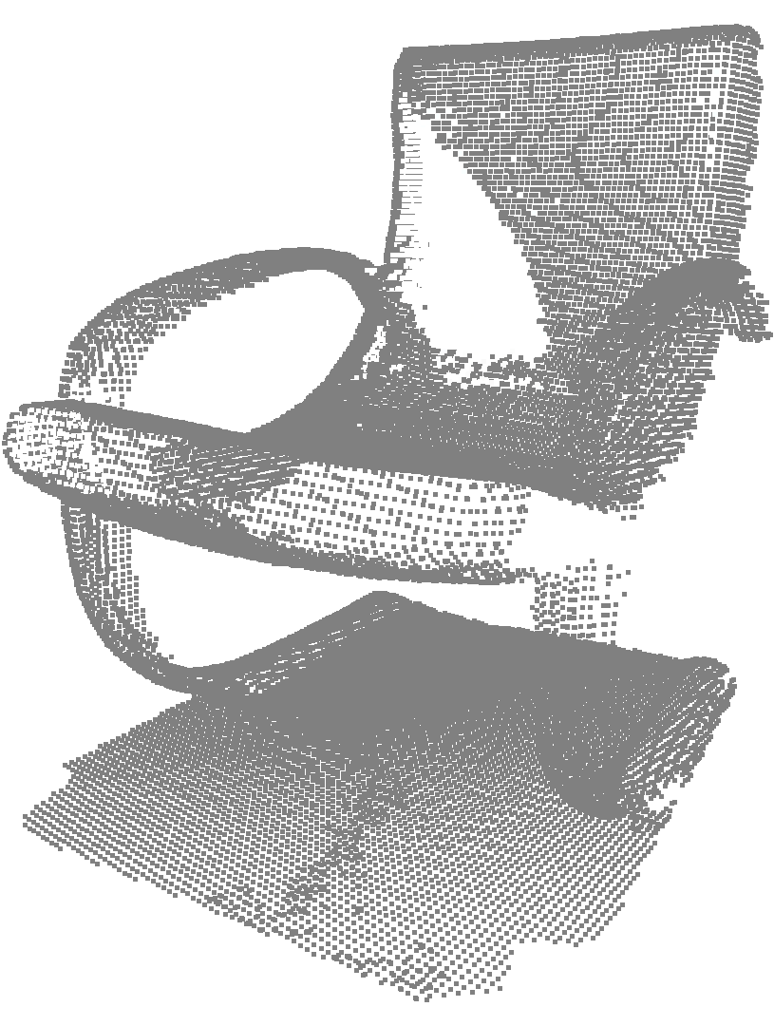
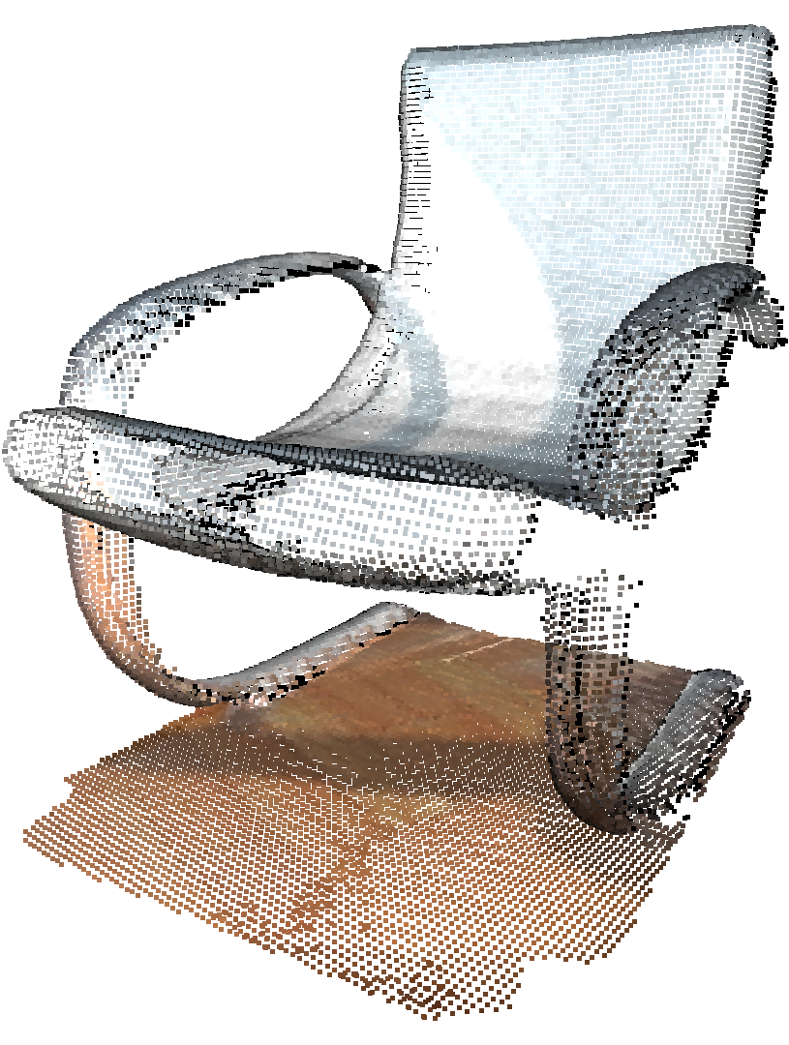


From 2D pixels to 3D points
Representation:
A discrete set of 3D coordinates $(x, y, z)$
Optional attributes: RGB, Intensity, Normals
Key differences:
Irregular & Unordered
Scale & Density Variance
We need a better interactive point cloud segmentation method for annotation!

Slide 3
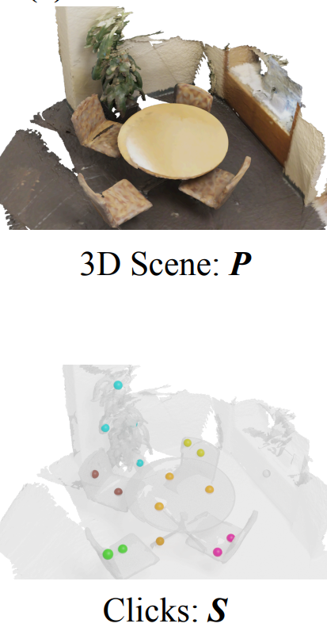
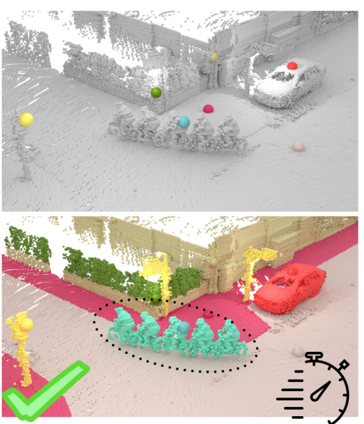
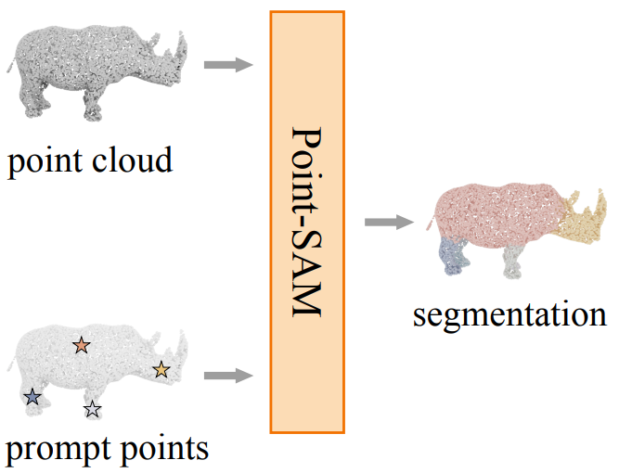
Existing Methods – spatial interaction
AGILE3D
PointSAM
Interactive4D

Slide 4
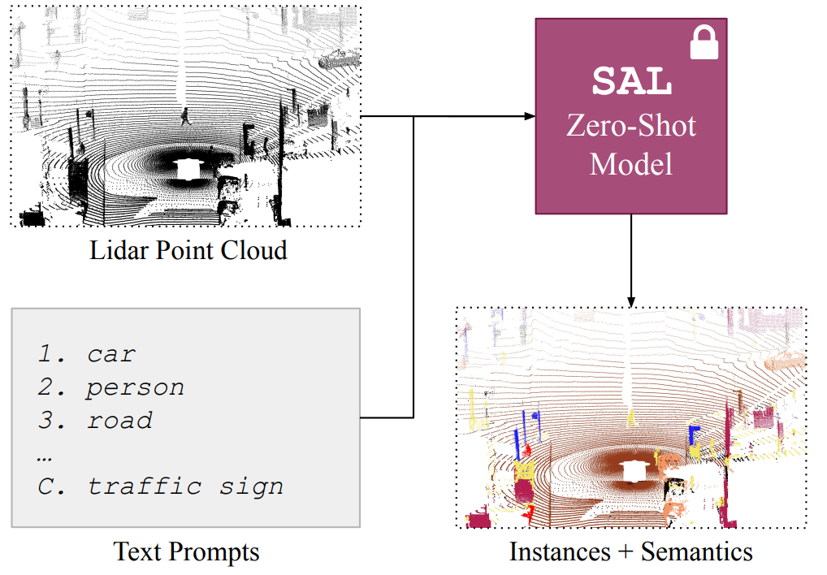
Existing Methods – textual interaction
SAL

Slide 5

Analyzing the Gaps
Domain-specific designs
Indoor
Indoor & Parts
Outdoor
Outdoor
spatial
spatial
spatial
textual
Single prompt modality

Slide 6
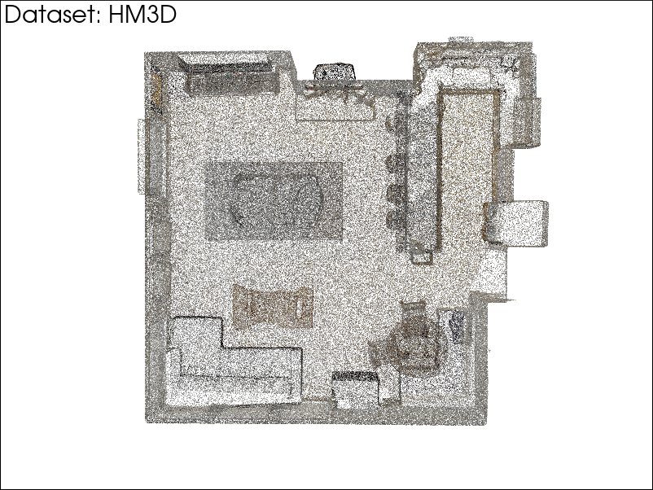
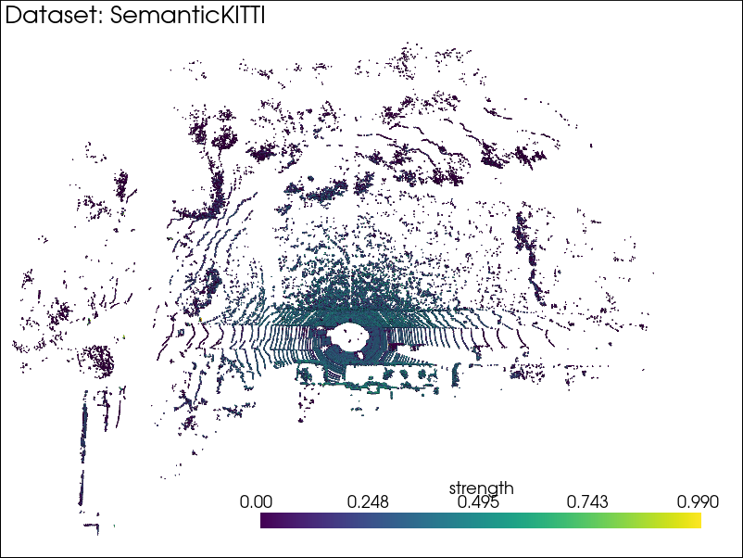
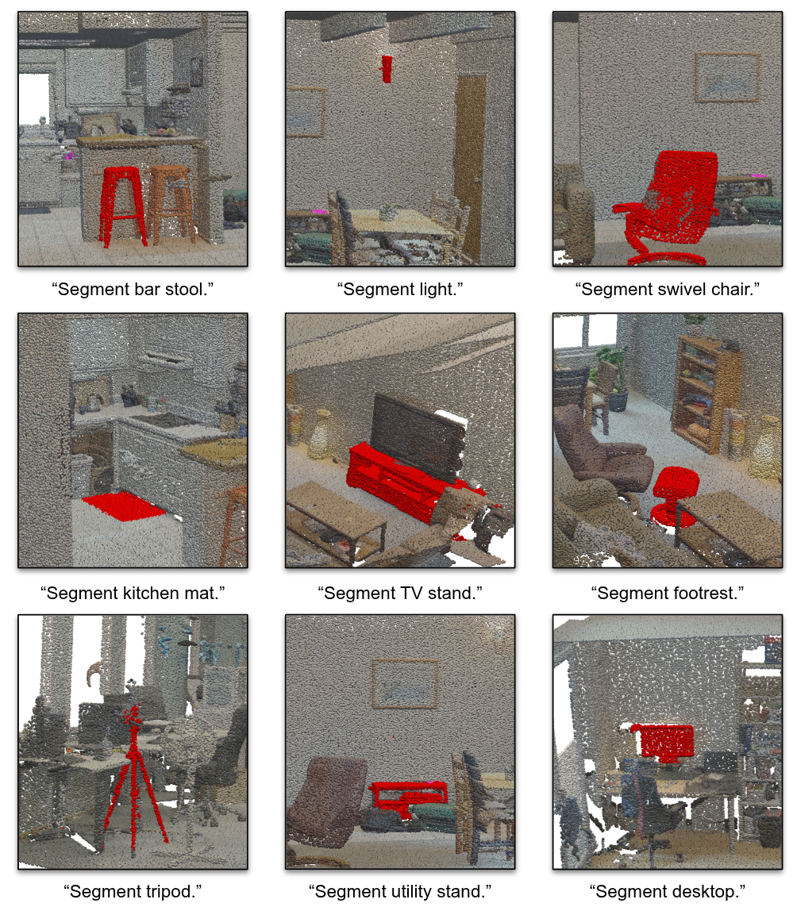
Our Goals
Segment any point cloud
Support flexible prompts
“chair”
Labels segmentation results
Object label: Monitor

Slide 7
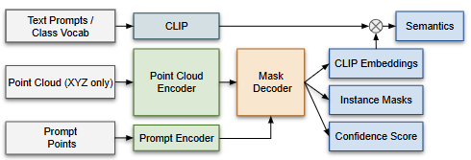


Our design
Spatial Guidance
Segment any point cloud
Support flexible prompts
Labels segmentation results
unified input format & point cloud encoder
spatial prompt encoder & mask decoder &
CLIP embedding alignment

Slide 8
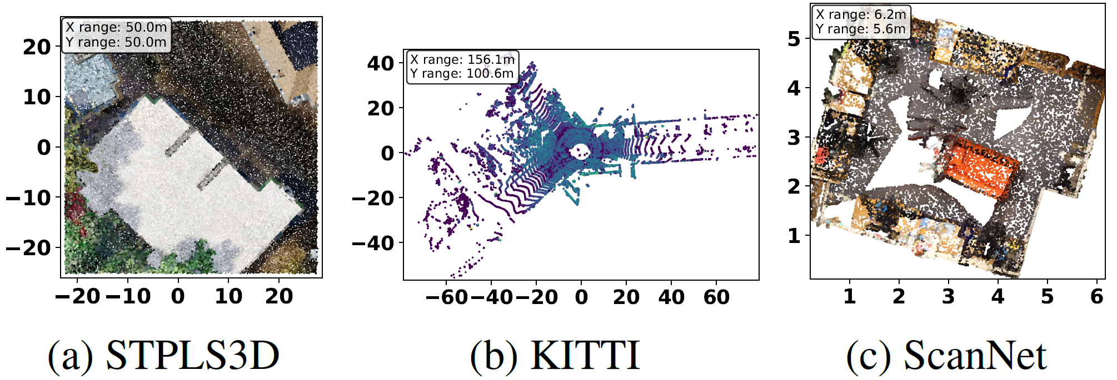
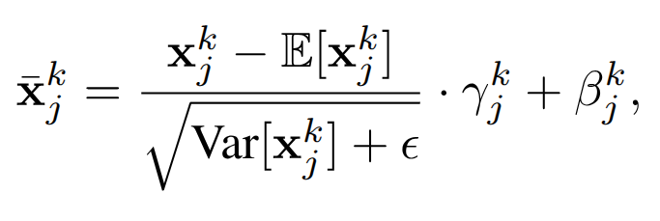
Problem – Multi-dataset Distribution Gap
Drastically different spatial scales
Varying point density
Different sensing geometry
Negative Transfer

Slide 9

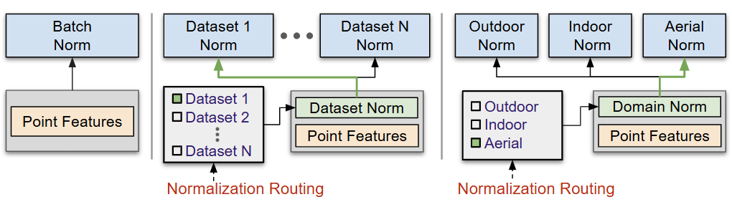
Dataset Normalization
Domain Normalization
aerial
outdoor
indoor
Separate normalization per dataset
Separate normalization per domain
Poor generalization to unseen datasets
Better generalization to unseen datasets

Slide 10



Can SNAP segment from text alone?
Can SNAP perform text-based segmentation without user-provided spatial prompts?
Spatial Guidance
Instance Masks
User-provided spatial clicks
CLIP-space Embeddings

Slide 11
Automated prompt generation – coarse proposal
We first generate sparse spatial prompts using a coarse voxel grid to obtain initial instance proposals.

Slide 12
Automated prompt generation – progressive refinement
We identify unsegmented regions and progressively refine proposals using finer voxel grids.

Slide 13
Automated prompt generation – final selection
We apply Non-Maximum Suppression (NMS) to remove duplicate masks.

Slide 14
Text-based segmentation without manual prompts
Can SNAP perform text-based segmentation without user-provided spatial prompts?
Yes! With a two-stage textual interaction pipeline!

Slide 15
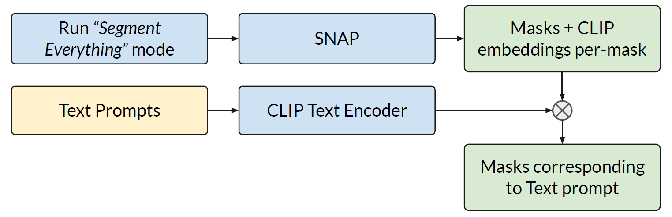
Text-based segmentation without manual prompts
Stage 1: Mask proposal generation with the automatic prompt generation algorithm.
Stage 2: Matching predicted CLIP embeddings to the input textual prompt.

Slide 16
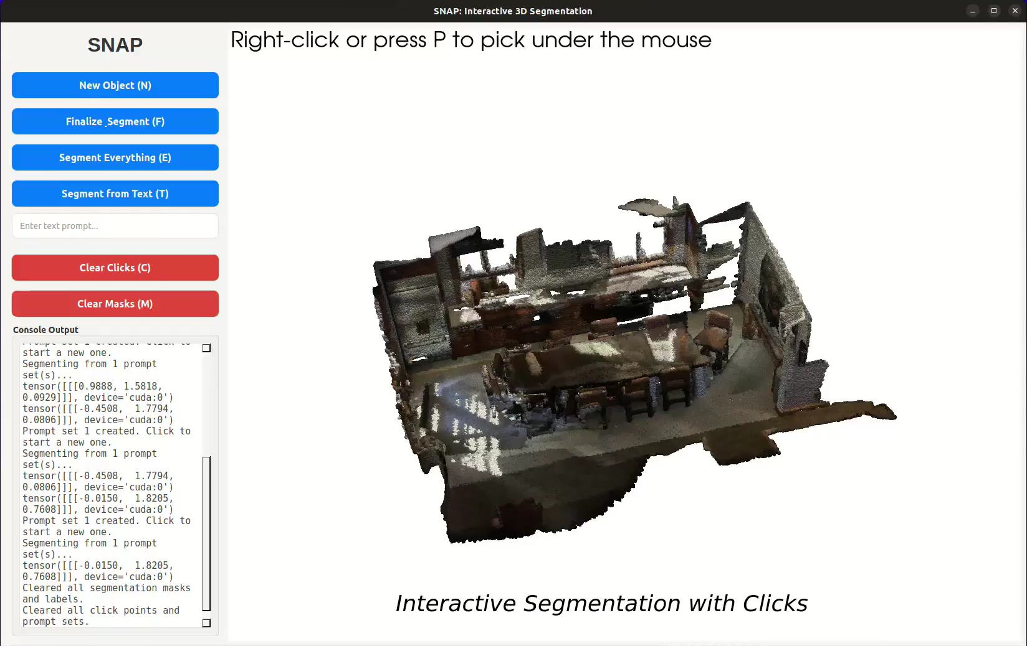
SNAP Demo

Slide 17
Spatial interaction – In-Distribution results

Slide 18
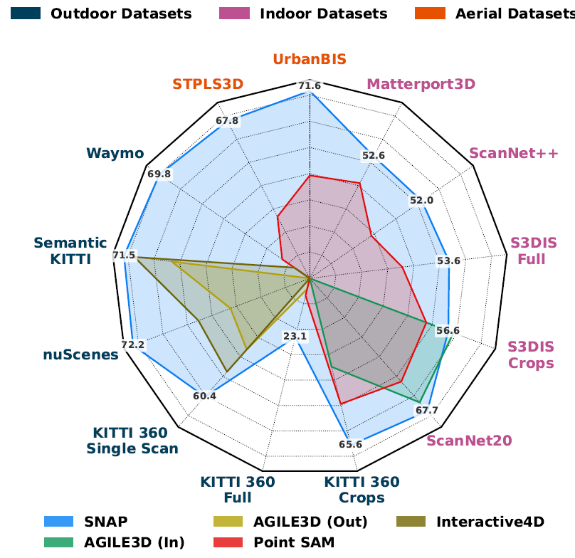
Spatial interaction – Zero-Shot results

Slide 19
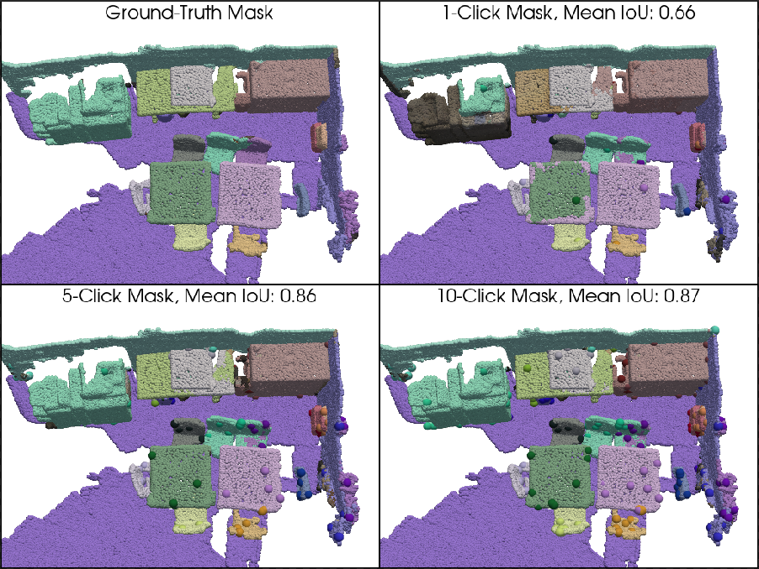
Spatial interaction – Qualitative results

Slide 20
Textual interaction – Panoptic results

Slide 21
Textual interaction – Open-Vocabulary results

Slide 22
Textual interaction – Qualitative results

Slide 23
Ablation – Domain Normalization

Slide 24
Ablation – Domain Normalization

Slide 25
Ablation – Automated Prompt Point Generation
68%

Slide 26
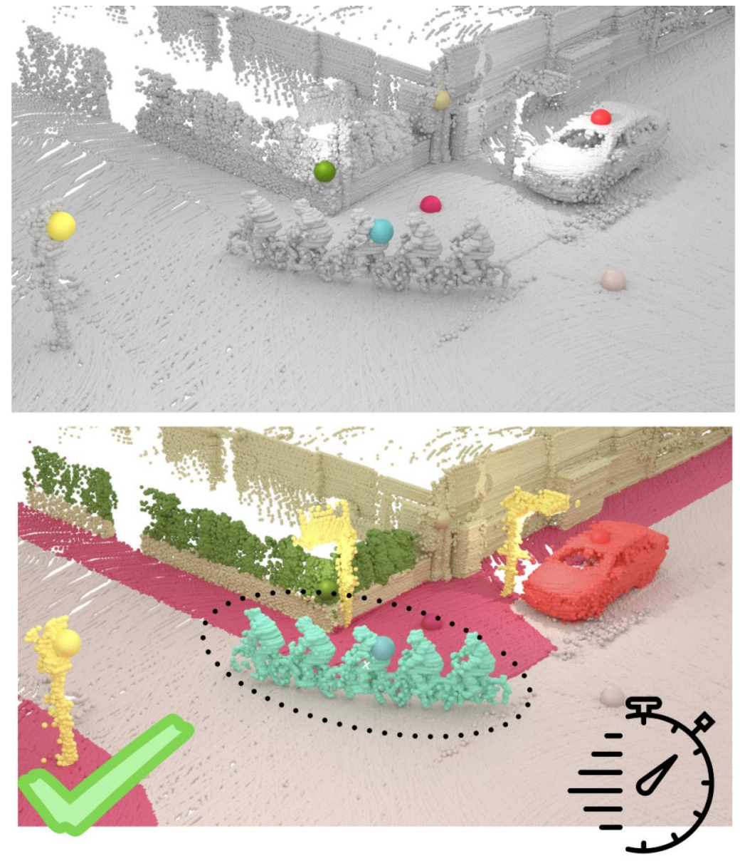
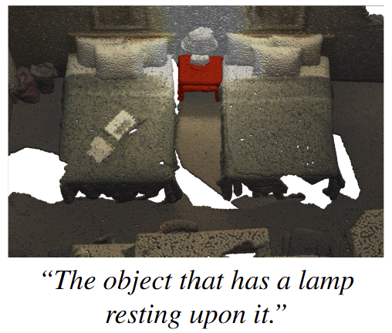

Limitations & Future Works
No negative click support
Not detailed text-based segmentation
Toward 4D segmentation

Slide 27
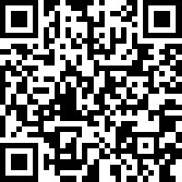
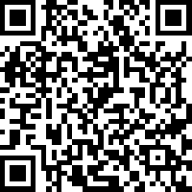
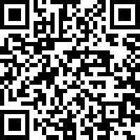
Thank you!
Project
Paper
Code

Slide 28
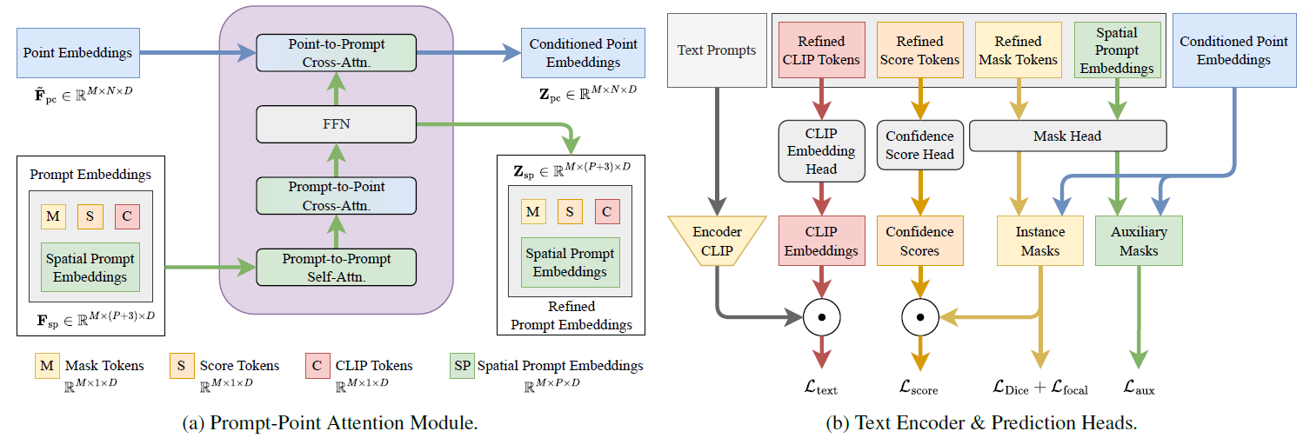
Mask decoding

Slide 29
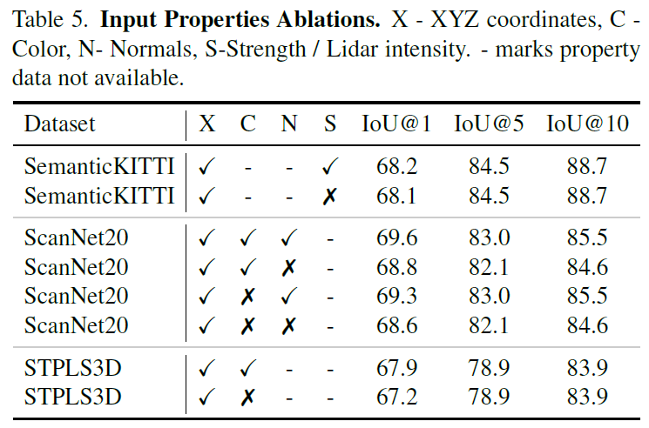
Ablation – Unified input format

Slide 30
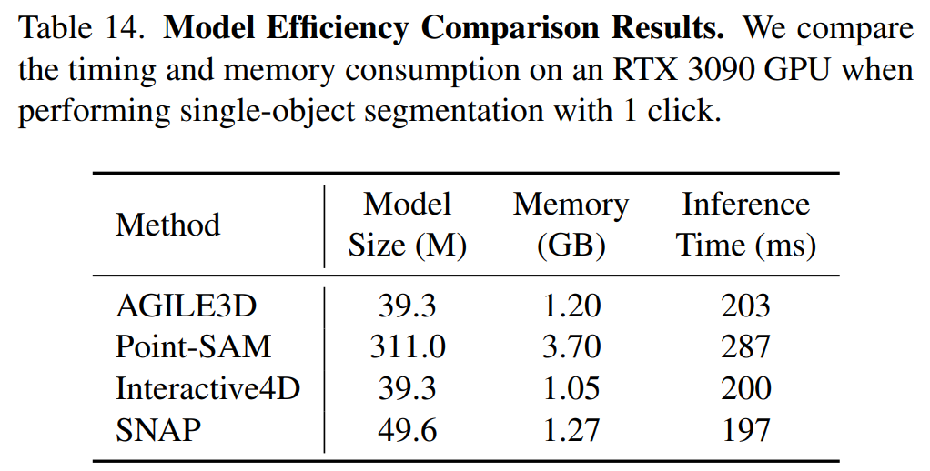
Memory & Time

